Slide 1
Web Security
Dr.K.Murugan

Slide 2
Cross-Site Scripting (XSS)
XSS is a very common vulnerability
  Would be vulnerability of the decade except SQL injections are often far more serious
  XSS is used for a client to attack another client, not to attack a server
An XSS vulnerability is as simple as echoing back user-input without sanitizing
  Ex: You submit: “XYZ!!(2” to a search engine and it replies with “XYZ!!(2 no results found”

Slide 3
“Security Context”
We define a security context to be the set of rules that govern how cookies are handled between domains
Users might have several contexts active at the same time
  Ex: An unexpired session token with a bank sitting in another browser window (logout or browser death usually purges these tokens, but users will often neglect to do either)

Slide 4
XSS
The idea of XSS is for an attacker to inject malicious javascript into a security context that it does not own
  And, as we know, this means things like session tokens can be sent anywhere we like

Slide 5
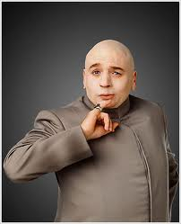
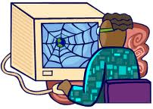
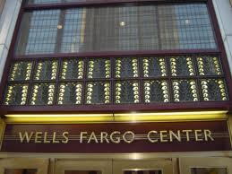
user connects to evil site
javascript executes as if
from bank; tokens stolen
Link to bank with malicious
javascript given as parameter
malicious javascript
reflected back to user with bank’s security context
Typically called
“reflected” XSS

Slide 6
Demo on moxie
Visit stateful.php to establish highly valuable session ID
View xss.php behavior
Look at ~drevil on moxie
  Note the warm innocent feel of the page
  View source on this page (note the encodings)
Examine steal.php
Click on link on drevil’s homepage
  Look in /tmp/stolen.txt

Slide 7
Stored XSS
Stored XSS is very similar
  Instead of using a reflection bug, the attacker stores javascript in a place where the victim is likely to read it (and thereby execute it)
  It’s usually the server’s responsibility to sanitize user input before storing it
    Consider a public forum where various users post their thoughts
      And their exploit code…
  Stored XSS is usually considered more serious
    No need to induce the user to establish a session then visit drevil’s site, which can be hard some times

Slide 8
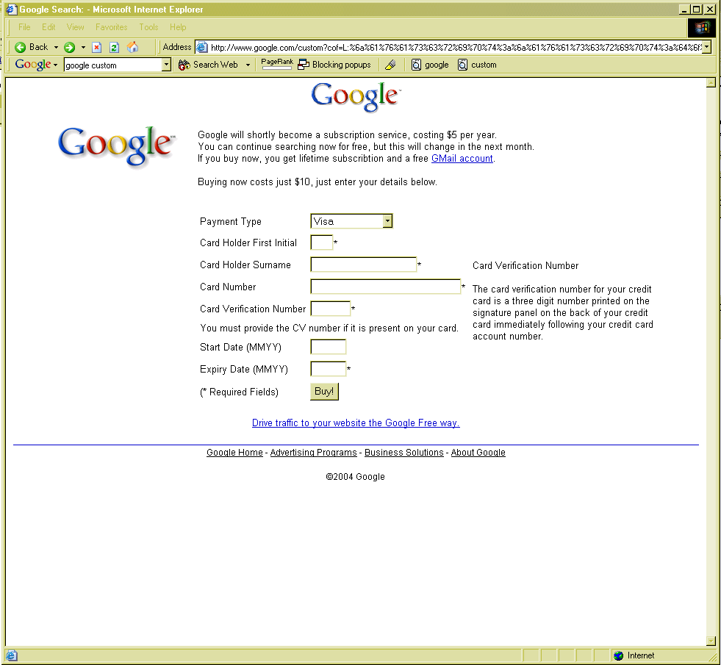
Note proper domain name
SSL would be enabled, if this were an SSL site

Slide 9
Samy XSS worm
Oct, 2005: myspace had an XSS vulnerability
  They used <script> filters, but 19-yr old Samy Kamkar found a way to bypass all of them
  He built an AJAX app so that every view of his profile added him as a friend and posted “…and most of all, Samy is my hero” to their page
  He also had the worm install itself so that any viewer of the page would propagate the worm

Slide 10
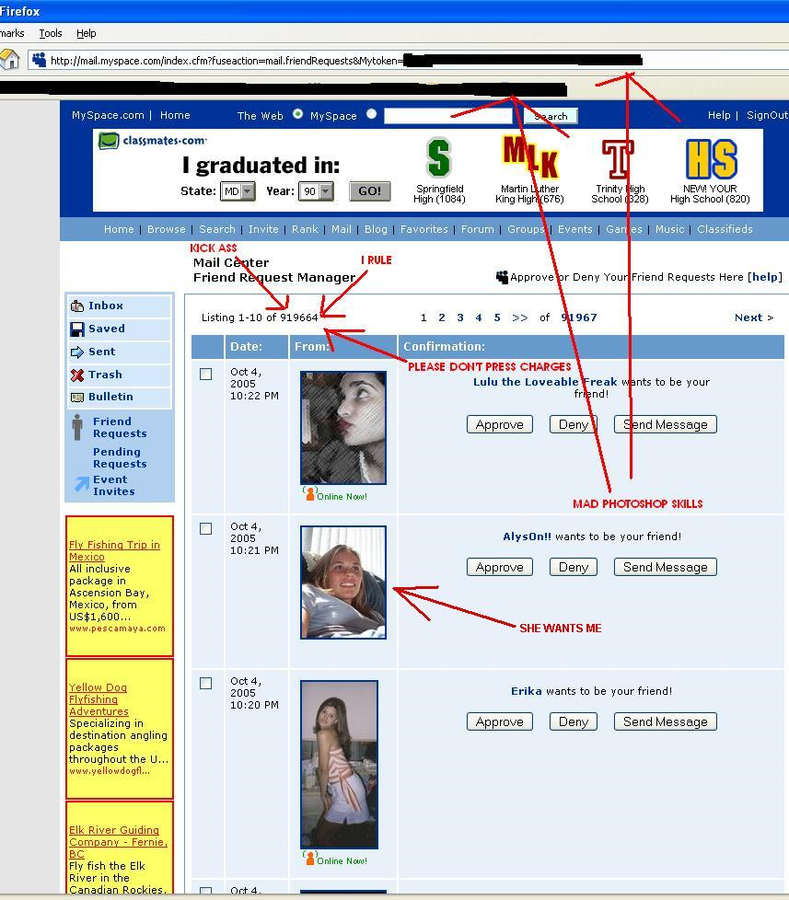

Slide 11
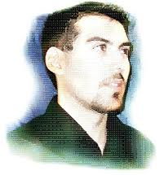
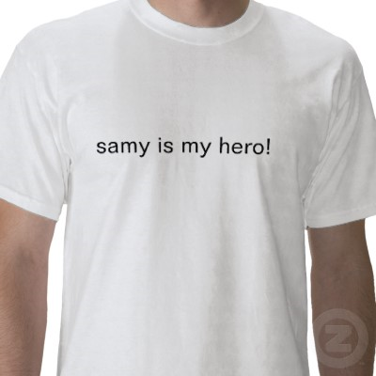
Three years probation, 90 days community service, and a book-deal

Slide 12
Finding XSS Vulnerabilities
Try entering ><script>alert(document.cookie)</script> in every user-input vector and monitor for appearance of this string from the site
  If string comes back unmodified, jackpot
    This is automatable
    Some XSS vulns will not be found by this technique, however, since <script> is often filtered out (as are < > /)
    Some XSS filters will miss ><script >, ><ScRiPt>, %3e%3cscript%3e, ><scr<script>ipt>, %00><script>

Slide 13
Good Practices (for security)
Create a session token on first visit
When performing authentication, destroy the old session and create a new one
Expire sessions after a short period (30-60 mins)
Destroy sessions after logout
Use SSL and mark session cookies as secure
Monitor User-Agent header; it shouldn’t change during a session

